Slide 1

Critical Thinking

Slide 2
Agenda:
What is critical thinking?
Critical reading
Critical writing

Slide 3
Look at the scenario below. Do you share the same feeling?
Student:
“I want you (the expert) to give me answers to the questions; I want to know the right answer.”
Teacher:
“I want you to become critical thinkers, which means I want you to challenge experts’ answers and pursue your own answers through active questioning. This means lots of hard work.”
Keeley, S. M. et al. (1995) ‘Coping with student resistance to critical thinking: What the psychotherapy literature can tell us’ In: College Teaching 43(4) pp.140-145.

Slide 4

The word critical has multiple meanings in English for academic purposes. Which definition would be central to your tutor marking your work?
  Important or important to the point of causing a threshold to be crossed, e.g., Once the temperature drops below the critical value, growth ceases.
  Evaluative, making an assessment according to a set of criteria, e.g., He was asked to write a critical review of the research in this field.
  Finding faults / criticizing, e.g., He was highly critical of the research in the field.
They should be more critical!
Alexander, O. et al. (2006) EAP essentials: a teacher’s guide to principles and practice. Reading, UK: Garnet.

Slide 5
What is critical thinking?

Slide 6
Varied definitions of critical thinking
“Critical thinking is the ability to think clearly and rationally about what to do or what to believe. It includes the ability to engage in reflective and independent thinking” (Lau and Chen, 2021).
“Critical thinking refers to students abilities' to identify issues and assumptions, recognize important relationships, make correct inferences, evaluate evidence or authority, and deduce conclusions” (Tsui, 2002:743).
But, what does it actually entail in reading and writing or your assignments?
Lau, J and Chan, J. (2021) What is critical thinking? At: http://philosophy.hku.hk/think/critical/ct.php
Tsui, L. (2002) ‘Fostering critical thinking through effective pedagogy’ In: The Journal of Higher Education 73 (6) pp.740-763.

Slide 7
Critical thinking covers:
Identifying other people’s positions, arguments and conclusions
Evaluating the evidence for alternative points of view
Weighing up opposing arguments and evidence fairly
Being able to read between the lines, seeing behind surfaces and identifying false or unfair assumptions
Recognising techniques used to make certain positions more appealing to others
Reflecting on issues in a structured way, bringing logic and conclusions about whether arguments are valid and justifiable, based on good evidence and sensible assumptions
Synthesising information
Presenting a point of view in a structured, clear, well-reasoned way that convinces others
Reading
Writing
Cottrell, S. (2011) Critical thinking skills: developing effective analysis and argument (2nd ed.). Basingstoke, UK: Palgrave Macmillan.

Slide 8
    Critical Reading
    An important skill to learn whilst studying on your course
    Reading critically is different to just reading for pleasure
    Critical reading means reading in order to extract key information from a text; and to evaluate, critically, the information you are provided with.

Slide 9
Checklist whist reading
Can you identify and evaluate the main argument of the piece?
What is its conclusion? Is there one? (Not having a conclusion suggests a weaker argument).
Are there any hidden assumptions or agendas? Does the author make any unsubstantiated claims based on little or weak evidence?
Has the writer considered alternative viewpoints?
Is the evidence used credible? Does the evidence support the writer’s conclusions?
Cottrell, S. (2019) The study skills handbook. Basingstoke, UK: Palgrave Macmillan.

Slide 10
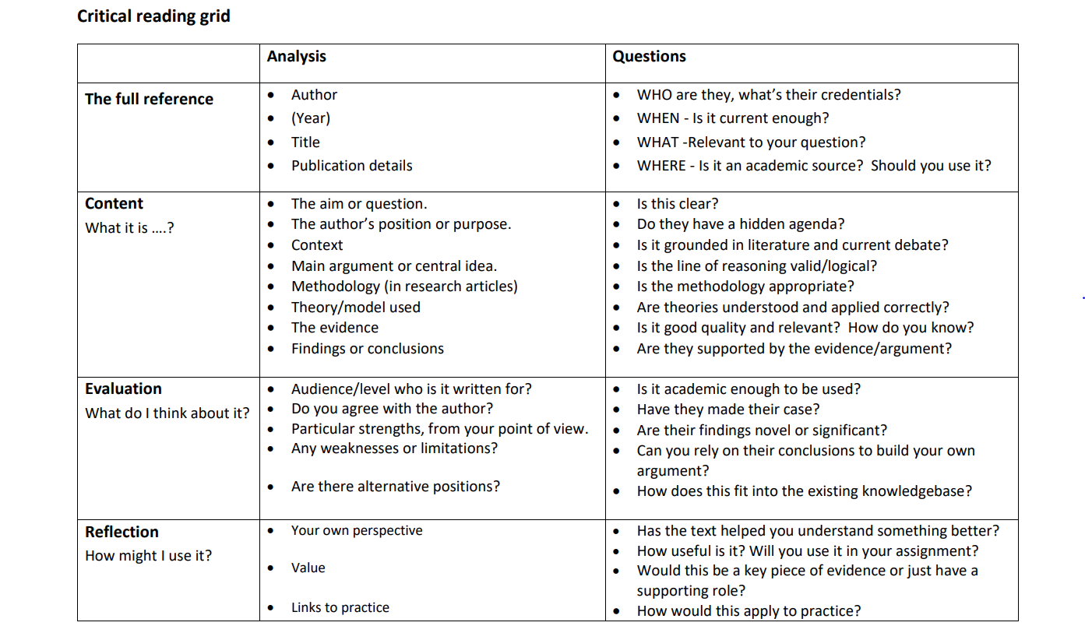
Cumbria University (s.d.) Critical reading grid. At:
https://my.cumbria.ac.uk/media/MyCumbria/Documents/Library/Critical-reading-grid.pdf

Slide 11
Criticality is often manifested by putting forth your arguments. How to construct them in academic writing?

Slide 12
What’s your reaction to this advert of Mars?
Watch the commercial on YouTube video at https://youtu.be/AE9zAummq7Q
In this video, Mars, a chocolate bar well-known in the UK, is advertised as “A Mars a day helps you work, rest and play.”
What’s your reaction to this advert and the slogan?

Slide 13
Thinking for Writing
Some possible first reactions:
“It’s just a silly advert “
“Those things are full of sugar!”
“I sometimes eat one but always regret it”
How would this translate to academic writing?

Slide 14
Constructing an argument (an example)
There is evidence to suggest that eating a Mars bar each day will give you a much-needed burst of energy or a “sugar rush”, especially in the afternoons when blood sugar levels are said to drop. Some studies have researched this effect on the human body (author, year). However, it is also clear that there are many negative effects on health from eating such sugary snacks on a daily basis (author, year). These effects include…
Argument
Evidence (academic sources)
Compare & contrast ideas
Elaborate on or explain ideas

Slide 15
(a) Convey a position or stance
(b) Justify and evaluate arguments
(c) Use good or reliable evidence
(d) Provide sensible assumptions
(e) Synthesise information
(f) Present a point of view in a structured, clear, well-reasoned way
(Adapted/summarised from Cottrell, 2011)
General Language Functions
Being cautious
Being critical
Classifying and listing
Compare and contrast
Defining terms
Describing trends
Describing quantities
Explaining causality
Giving examples
Signalling transition
Writing about the past
(List of General Language Functions from Academic Phrasebank)
Cottrell, S. (2011) Critical thinking skills: developing effective analysis and argument (2nd ed.). Basingstoke, UK: Palgrave Macmillan.
University of Manchester (2021) Academic Phrasebank. At: http://www.phrasebank.manchester.ac.uk/
Notes:
Dr John Morley, Director, the University-wide Language Programmes, University of Manchester

Slide 16
Often in your assignments, you may include both descriptive writing and critical/analytical writing. How are they different?

Slide 17
Descriptive writing | Critical writing
Reports what happened | Evaluates the significance of what happened Hypothesises why something happened
Outlines what something is like | Evaluates the strengths and weakness of something
States evidence | Argues, using, evidence
Tells what a theory says | Determines why a theory is relevant
Describes an method | Justifies the use of a particular method over another
Quotes, summaries or paraphrases information from different writers | Compares and contrasts the views of different writers Considers the relevance or validity of information from different writers
Gives examples of different items | Differentiates between items, possibly using examples
States the findings of a study | Distinguishes between important and less important findings of a study
Lists details | Evaluates the relative significance of details
Lists information | Organises information in order of importance
Lists options | Critiques the options in order to select the best one
Smith, S. (2020) Critical writing. At: https://www.eapfoundation.com/writing/critical/

Slide 18
How is critical thinking manifested in this excerpt of student writing?

Slide 19
To evaluate and examine the methods of identity formation amongst young people, I am going to focus on micro-celebrities as my primary research examples. Marwick (2014:115) describes micro-celebrity as “a way of thinking of oneself as a celebrity, and treating others accordingly.” They are in-between of a non-famous person and a traditional celebrity. Rather than be awarded the title of a celebrity, a microcelebrity is self-proclaimed, and strategically attempts to construct themself as someone of fame and importance. The concept of the micro-celebrity is something that has been made possible by Web 2.0 and social media platforms, as social media allow individuals to act out any portrayal that they wish. Primary examples from young traditional celebrities are widely available; however, because of their celebrity status, public accessible information about their life and how they explore and construct their identity may be distorted, therefore making them a biased and flawed example of the identity formation period for the average young person. On the other hand, it is challenging to find examples from a ‘normal’ young person, without referring to people that I know. Micro-celebrities are thus ideal primary research examples as they are known enough for me to look up their public social media profiles without the need of consent. Furthermore, as photographs uploaded to social media can be a key signifier of how they identify themself and wish to be viewed, in this research I am going to use images from the social media profiles of some micro-celebrities.
The text has been slightly revised from the original to ensure grammatical accuracy: Gordon, L (2016) Web 2.0: identity and self-exploration. [BA Dissertation] University for the Creative Arts. At: https://resourcebank.uca.ac.uk/pages/search.php
Notes:
See a separate document for the analysis of the text

Slide 20
Useful online resources
Websites:
TED-Ed 5 tips to improve your critical thinking https://ed.ted.com/lessons/5-tips-to-improve-your-critical-thinking-samantha-agoos
University of Manchester Academic Phrasebank http://www.phrasebank.manchester.ac.uk/
University of Hull (2020) Critical writing https://libguides.hull.ac.uk/criticalwriting/critical-writing
MOOCs (Massive Open Online Courses):
Open University Extending and developing your thinking skills https://www.open.edu/openlearn/education-development/extending-and-developing-your-thinking-skills/content-section-0?active-tab=description-tab
Open University Succeeding postgraduate study https://www.open.edu/openlearn/education-development/succeeding-postgraduate-study/content-section-overview?active-tab=content-tab
University of Leeds Critical thinking at university: an introduction https://www.futurelearn.com/courses/critical-thinking-at-university

Slide 21

Questions?

