Slide 1

Using visual sources to develop analytical thinking:
a 3-stage method with an image
Notes:
A webinar explaining the session is available as an MP4 file.
It was recorded at the annual ALDinHE conference, 28 May 2020, that took the form of LD@3 chats.

Slide 2



Elements of Writing
Description
What?
When?
Who?
Where?
Describes/outlines/summarises/defines a theory, a viewpoint or a situation
Provides context (background) to a subject
= Tells or restates
Analysis & Evaluation
Why?
How?
So what?
What next?
Compares/explores/assesses strengths and weaknesses (to understand complexity and depth)
Provides reasons and draws informed conclusions
= Comments, makes links and shows implications
How do you know?
Scholarly support
Notes:
I start the session by walking the students through the main elements of writing and telling them that we will explore them in the session through a visual example.

Slide 3
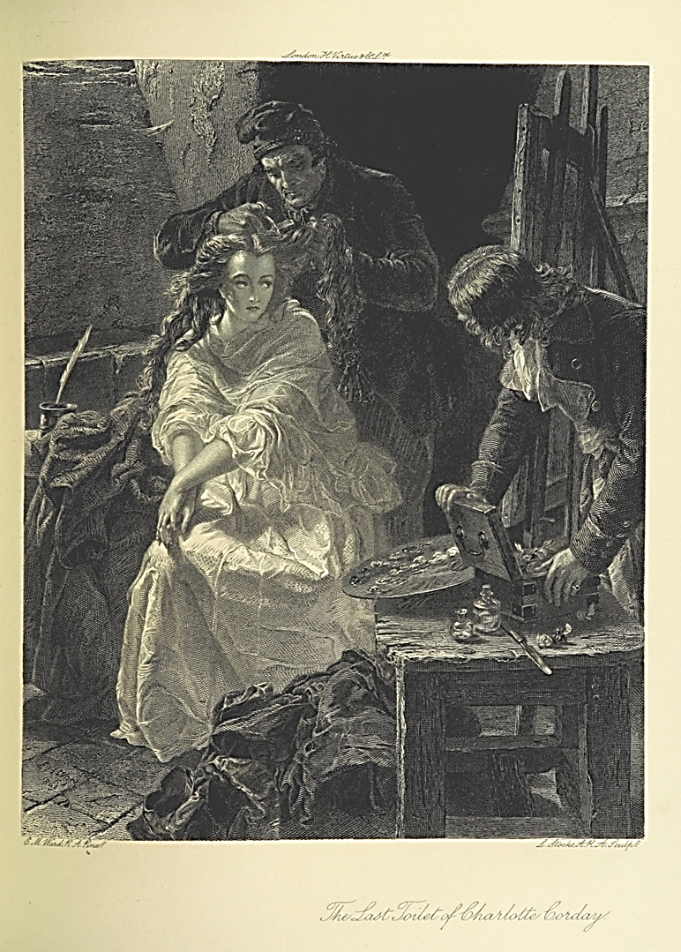
Writing exercise with an image
3 stages:
Description
Analysis
Critical analysis
The British Museum
http://www.britishmuseum.org/research/collection_online/collection_object_details.aspx?objectId=3203249&partId=1&people=106348&peoA=106348-2-60&page=1
Notes:
From the start, it’s important that the students don’t know anything about the image and don’t check who Charlotte Corday was. The less they know the more imaginative and exploratory their discussions will be. Once they do a bit of research, their interpretations are limited by the historical context. This should be saved for the final stage, however.

Slide 4
Writing exercise with an image
Work in pairs or small groups.
Brainstorm ideas and jot them down (sentences, bullet points, key words).
Stage 1 | Stage 2 | Stage 3
Notes:
Instructions for students:
Call out words or phrases or sentences, etc.
One person writes them down in the first column. Leave a little bit of space in between in case you want to add anything later.
The aim is to explore the image/topic in multiple ways and generate a range of observations/ideas.
You can work alone but it’s better to have another person offer a different perspective.

Slide 5
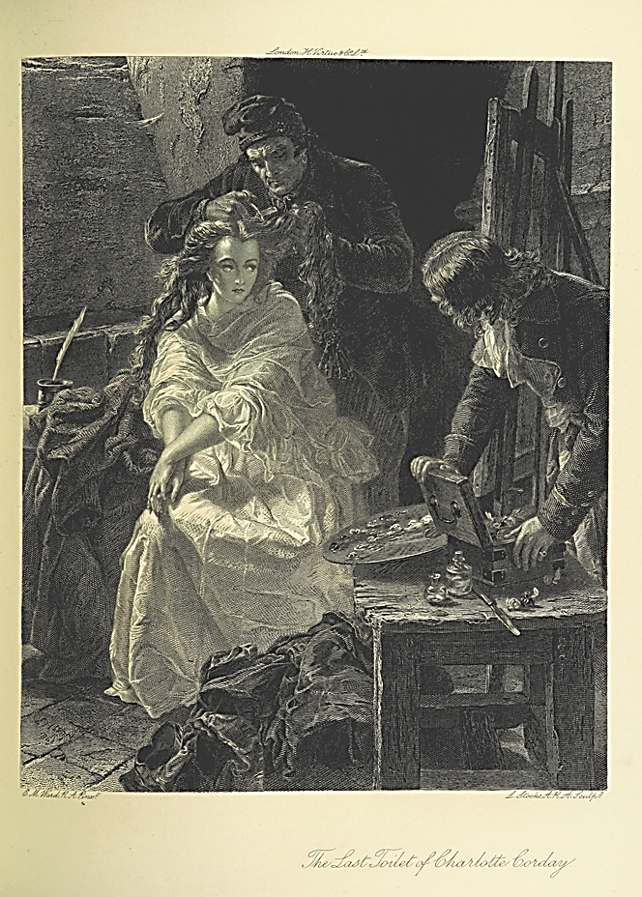
Stage 1: Description
Look at the image
- what do you see?
Tip:
Imagine that you’re describing it to a person on the phone
‘Looking is not as simple as it looks.’
Ad Reinhardt
Stage 1 Description | Stage 2 | Stage 3
Observation 1 Observation 2 Observation 3 ……
Notes:
Here, it’s important to suppress any temptation to analyse and evaluate what you see. Only describe.
This is how I sometimes guide students:
Imagine that you’re calling a friend from your trip to the museum and describing the picture to them so they can recreate it in their mind. This will allow you to describe all the details you can see in it without analysing their meaning for the listener. For example, you could say that she looks like she’s rich, but what does it mean to a person who can’t see her? Describing the fabric of her dress, the way she’s sitting, how she presents herself – this is what makes you say she looks rich. But this could be different to how someone else might imagine/interpret a rich person, so it’s better to stick to objective descriptors.

Slide 6
Describe the image
What?
When?
Who?
Where?
Examples of questions:
What kind of picture is it?
Who is involved? Where are they? What do they look like? Etc.
What is happening in the picture?
Notes:
Students discuss in small groups and share their observations with the rest of the class. It’s important to make sure that they only describe, despite the natural tendency to analyse or give meaning to these observations.

Slide 7

Tell me about this picture…
Description
Sitting in a dark room
Having hair cut
A palette knife
A woman and two men
Hands interlaced
Notes:
After the discussion, here is a shortened summary. Hopefully, the students would come up with many more observations, but this is just an example of a few descriptive points that could be made about the image, for the sake of argument. The last two items usually go unnoticed so I draw particular attention to them here.

Slide 8
Example of a descriptive paragraph
In this black and white engraving, a woman is sitting in a dark room, clad in an elegant white dress, with hands interlaced on her knee. A man in a conical cap is cutting her hair while she’s looking longingly at a painting on the easel to her left. Her eyes look alert. An artist is watching her as he is packing up his paints on the table. Other objects in the room include a palette knife in the right hand corner and a quill pen on the left, as well as a heap of dark fabric at the foot of the woman.
Notes:
An example of how this description could be written as a paragraph. If you close your eyes when I read it, you should be able to imagine the engraving.

Slide 9
Stage 2:
Analyse the image
- what does it mean?
Stage 1 Description | Stage 2 Analysis | Stage 3
Observation 1 Observation 2 Observation 3 ….. | Interpretation 1 Interpretation 2 Interpretation 3 ….
Notes:
This stage is about asking questions and providing interpretations, and I encourage the students to make the most outrageous claims about what the particular elements of the picture could mean.

Slide 10
Analyse the image
Why?
How?
So what?
What next?
Examples of questions:
How do the woman’s clothing, posture and facial expression reveal her personality, mood and status?
Similarly, what do these elements tell us about the men?
What are the implications of the different elements in the composition?
Notes:
Analysis means asking questions. For example, why is she there? Why is her dress white? Why did the artist portray her hair in an exaggerated way? Why is her hair being cut? Why is her portrait being painted? What is this dark room? There are so many questions to ask about this image.
The essence of this stage is to speculate as much as possible. I encourage the students to be bold in their interpretations – it doesn’t have to be true, it’s about exploring possibilities. E.g., the woman’s white dress = innocence; the exaggerated hair = symbol of femininity; the hair cutting = humiliation; her portrait painted in such conditions = she’s important; etc.

Slide 11
Analyse this picture…
Description
A woman and two men
Innocence and revolution
Unlikely place
Humiliating ritual
Modesty
Analysis
Sitting in a cell
Having hair cut
Hands interlaced
A palette knife
Hint at a crime
Notes:
Each of these observations has a potential interpretation (one of many), so each description now needs analysis. This slide brings together the observations identified before and their interpretations/analysis.

Slide 12
Example of a descriptive and analytical paragraph (integrated)
The central focus of this black and white engraving is Charlotte Corday sitting in a prison cell, a seemingly unlikely place for a beautiful woman like that. She is clad in an elegant white dress, which stands out in the darkness of the surroundings creating a jarring and intriguing portrait that evokes threatened innocence and virtue. Her hands are clasped on her knee, implying modesty and anxiety. A man in a conical cap, popular in mid-nineteenth century, is cutting her hair – symbol of her femininity – while she’s looking longingly at a painting on the easel to her left. The shearing is a humiliating ritual and her eyes look alert, creating an impression of determination in the face of indignity. An artist is watching her, perhaps looking for approval of his portrait, as he is packing up his paints on the table. Other objects in the cell include a palette knife in the right hand corner, which hints at a possible crime Corday committed, and a quill pen on the left that symbolises the power of written word, as well as a heap of dark fabric at the foot of the woman. The mood is sombre and anticipating as she will soon be walked off to her execution.
Plain text = descriptive writing Green text = analytical writing
Notes:
It’s the same paragraph as before (in black), but now analytical (green) elements are added to show how they can be integrated. In this way, students can learn how not to separate description from analysis.

Slide 13
Stage 3:
Reveal the image
- how/what do you know?
Stage 1 Description | Stage 2 Analysis | Stage 3 Critical
Observation 1 Observation 2 Observation 3 …. | Interpretation 1 Interpretation 2 Interpretation 3 ….. | Support 1 Support 2 Support 3 ….
Notes:
The essence of this third stage is to verify all our observations and speculations with evidence. Charlotte Corday was a real person and research into her life reveals a lot of interesting facts that will confirm or refute some of the speculations made in stage 2. This stage emphasises the importance of research and sound knowledge base required for any academic analysis.

Slide 14
Reveal the image
How/what do you know?
What is the title of it? Who made it?
The Last Toilet of Charlotte Corday by E.M Ward
When was it created?
c.1869, in London
Who was Charlotte Corday?
The assassin of Jean-Paul Marat, a French Revolutionary journalist (1793)
What historical event is it related to?
The French Revolution, 1789-1799
What else would you need to know in order to produce a complete analysis?
e.g. about Charlotte Corday, Jean-Paul Marat, the Revolution in general, this execution in particular, women’s representations in art, Corday’s representations, etc.
Notes:
Here’s some basic information about Corday and the events that this image relates to. There are multiple visual representations of her in the history of art, because she fascinated artists. But this particular engraving is quite unique among them.
The reference list at the end of this exercise reveals the range of sources that could be used to explore it further, but at this point I usually just tell the students her story, so they can make sense of it (and verify their interpretations) straight away.

Slide 15
Critically analyse this picture…
Description
A woman and two men
Innocence and revolution
Analysis
Critical Evaluation
Sitting in a prison cell
Having her hair cut
Hands interlaced
A palette knife
Unlikely place for a woman
Humiliating ritual
Modesty
Hint at a crime
• Commemorated in art – fascination
• Challenged women’s place in revolution
• Readied for the guillotine
• Proven virgin
• Killed Jean Paul Marat
Notes:
The third frame (evaluation) adds knowledge from research to the previously made observations (description) and interpretations (analysis).

Slide 16
Example of a critical analytical writing paragraph (Harvard)
The central focus of this black and white engraving is Charlotte Corday sitting in her prison cell, a seemingly unlikely place for a beautiful woman like that. It was created by E.M. Ward, English historical painter and illustrator (Bendiner, 2004) and published in London in 1869 (The British Museum), seven decades after the event it represents. As the famous assassin of the French revolutionary Jean-Paul Marat during the terror stage of the French Revolution, in 1793, Corday quickly became a subject of not only multiple paintings, engravings and cheap illustrations but also plays, novels, short stories and historical narratives (Kindleberger, 1994, p.971). In this representation, she is clad in an elegant white dress, which stands out in the darkness of the surroundings creating a jarring and intriguing portrait that evokes innocence and virginity, which her post mortem confirmed much to the chagrin of her critics (Gelbart, 2004, p.205). Her hands are clasped on her knee, implying modesty and anxiety. A man in a conical cap, also called a Phrygian cap or a liberty cap as it was a Roman symbol of freedom (Korshak, 1987), is cutting her hair – symbol of her femininity – while she’s looking longingly at a painting on the easel to her right. Her ultra-feminine portrayal could be seen as a response to the contemporary negative representations of her as an unattractive, embittered and man-hating militant (Gullickson, 2014). The shearing is a humiliating ritual and her alert eyes create an impression of determination in the face of indignity. The artist whom she requested to paint her portrait, possibly Jean Jacque Haure (Gelbart, p.204), is watching her, perhaps looking for approval of his portrait, as he is packing up his paints on the table. Other objects in the cell include a palette knife in the right hand corner, which hints at the crime Corday committed when she plunged a kitchen knife into Marat’s heart killing him instantly, and a quill pen on the left that symbolises the power of written word, which is what Corday acknowledged by assassinating the journalist whom she saw as instigating hatred and representing the ‘tyranny of the mob’ (Yarrington and Everest, 2016, p. 7). The mood is sombre and anticipating as she will soon be walked off to her execution at the guillotine, the preferred method of decapitating the enemies of state during the Reign of Terror in Revolutionary France (Croker, 1853). Following her political act, Corday became a mythical figure, a symbol of the French revolution, to which visual representations such as this one significantly contribute (Hilger, 2010, p.71).
Plain text = descriptive Green text (Bold) = analytical Red (underlined) = academic writing
Notes:
This piece of writing looks a bit intimidating, but it does reflect how much of any academic writing is derived from sources (red underlined).

Slide 17
Example of a critical analytical writing paragraph (MHRA, sans footnotes)
The central focus of this black and white engraving is Charlotte Corday sitting in her prison cell, a seemingly unlikely place for a beautiful woman like that. It was created by E.M. Ward, English historical painter and illustrator and published in London in 1869, seven decades after the event it represents.¹ As the famous assassin of the French revolutionary Jean-Paul Marat during the terror stage of the French Revolution, in 1793, Corday quickly became a subject of not only multiple paintings, engravings and cheap illustrations but also plays, novels, short stories and historical narratives.² In this representation, she is clad in an elegant white dress, which stands out in the darkness of the surroundings creating a jarring and intriguing portrait that evokes innocence and virginity, which her post mortem confirmed much to the chagrin of her critics.³ Her hands are clasped on her knee, implying modesty and anxiety. A man in a conical cap, also called a Phrygian cap or a liberty cap as it was a Roman symbol of freedom, is cutting her hair – symbol of her femininity – while she’s looking longingly at a painting on the easel to her right.⁴ Her ultra-feminine portrayal could be seen as a response to the contemporary negative representations of her as an unattractive, embittered and man-hating militant.⁵ The shearing is a humiliating ritual and her alert eyes create an impression of determination in the face of indignity. The artist whom she requested to paint her portrait, possibly Jean Jacque Haure, is watching her, perhaps looking for approval of his portrait, as he is packing up his paints on the table.⁶ Other objects in the cell include a palette knife in the right hand corner, which hints at the crime Corday committed when she plunged a kitchen knife into Marat’s heart killing him instantly, and a quill pen on the left that symbolises the power of written word, which is what Corday acknowledged by assassinating the journalist whom she saw as instigating hatred and representing the ‘tyranny of the mob’.⁷ The mood is sombre and anticipating as she will soon be walked off to her execution at the guillotine, the preferred method of decapitating the enemies of state during the Reign of Terror in Revolutionary France.⁸ Following her political act, Corday became a mythical figure, a symbol of the French revolution, to which visual representations such as this one significantly contribute.⁹
Plain text = descriptive Green text (Bold) = analytical Red (Underlined) = academic writing
Notes:
Just for comparison, the same text in a different referencing style, more often used in the humanities, esp. history.

Slide 18
Reference List (Harvard)
Bendiner, K. (2004) ‘Ward, Edward Matthew (1816–1879)’. Oxford Dictionary of National Biography. Oxford University
Press. Available at http://www.oxforddnb.com/view/article/28683 (Accessed: 1 June 2016).
Croker, J.W. (1853) History of the Guillotine. London: J. Murray.
Gelbart, N.R. (2004) ‘The Blonding of Charlotte Corday’. Eighteenth-century studies 38.1, pp.201-221.
Gullickson, G.L. (2014) ‘Militant Women: representations of Charlotte Corday, Louise Michel and Emmeline Pankhurst’.
Women’s History Review 23.6, pp.837-852.
Hilger, S. (2010) ‘The Murderess on Stage: Christine Westphalen’s Charlotte Corday (1804)’. In: Bielby, C. and Richards, A.,
eds., Women and Death 3: Women's Representations of Death in German Culture Since 1500. New York: Camden House.
Kindleberger, E.R. (1994) ‘Charlotte Corday in text and image: A case study in the French Revolution and women's
history’. French Historical Studies, pp.969-999.
Korshak, Y. (1987) ‘The Liberty cap as a revolutionary symbol in America and France’. Smithsonian Studies in American
Art 1.2, pp.53-69.
Ward, E.M. (1869) ‘The Last Toilet of Charlotte Corday’ [engraving]. London. British Museum Collection Online. Available at
http://www.britishmuseum.org/research/collection_online/collection_object_details.aspx (Accessed: 1 June 2016).
Yarrington, A. and Everest, K. eds. (1993) Reflections of Revolution: Images of Romanticism. London and New York:
Routledge.
Notes:
I show the reference list in order to highlight how much research may sometimes have to be conducted for even quite a short essay.

Slide 19
Bibliography (MHRA)
Bendiner, K., ‘Ward, Edward Matthew (1816–1879)’, Oxford Dictionary of National Biography (Oxford University
Press: 2004), available at http://www.oxforddnb.com/view/article/28683 (Accessed: 1 June 2016)
Croker, J.W., History of the Guillotine (London: J. Murray, 1853)
Gelbart, N.R., ‘The Blonding of Charlotte Corday’, Eighteenth-century studies 38.1 (2004), pp.201-221
Gullickson, G.L., ‘Militant Women: representations of Charlotte Corday, Louise Michel and Emmeline Pankhurst’,
Women’s History Review 23.6 (2014), pp.837-852
Hilger, S., ‘The Murderess on Stage: Christine Westphalen’s Charlotte Corday (1804)’, in: Bielby, C. and Richards, A.,
(eds.), Women and Death 3: Women's Representations of Death in German Culture Since 1500 (New York: Camden
House, 2010)
Kindleberger, E.R., ‘Charlotte Corday in text and image: A case study in the French Revolution and women's
history’, French Historical Studies (1994), pp.969-999
Korshak, Y., ‘The Liberty cap as a revolutionary symbol in America and France’, Smithsonian Studies in American
Art 1.2 (1987), pp.53-69
Ward, E.M., ‘The Last Toilet of Charlotte Corday’ (1869), London, British Museum Collection Online, available at
http://www.britishmuseum.org/research/collection_online/collection_object_details.aspx (Accessed: 1 June 2016)
Yarrington, A., and K. Everest, (eds.) Reflections of Revolution: Images of Romanticism (London and New York:
Routledge, 1993)
Notes:
An MHRA bibliography, for comparison.

Slide 20
The central focus of this black and white engraving is Charlotte Corday sitting in her prison cell, a seemingly unlikely place for a beautiful woman like that. It was created by E.M. Ward, English historical painter and illustrator (Bendiner, 2004) and published in London in 1869 (The British Museum), seven decades after the event it represents. As the famous assassin of the French revolutionary Jean-Paul Marat during the terror stage of the French Revolution, in 1793, Corday quickly became a subject of not only multiple paintings, engravings and cheap illustrations but also plays, novels, short stories and historical narratives (Kindleberger, 1994, p.971). In this representation, she is clad in an elegant white dress, which stands out in the darkness of the surroundings creating a jarring and intriguing portrait that evokes innocence and virginity, which her post mortem confirmed much to the chagrin of her critics (Gelbart, 2004, p.205). Her hands are clasped on her knee, implying modesty and anxiety. A man in a conical cap, also called a Phrygian cap or a liberty cap as it was a Roman symbol of freedom (Korshak, 1987), is cutting her hair – symbol of her femininity – while she’s looking longingly at a painting on the easel to her right. Her ultra-feminine portrayal could be seen as a response to the contemporary negative representations of her as an unattractive, embittered and man-hating militant (Gullickson, 2014). The shearing is a humiliating ritual and her alert eyes create an impression of determination in the face of indignity. The artist whom she requested to paint her portrait, possibly Jean Jacque Haure (Gelbart, p.204), is watching her, perhaps looking for approval of his portrait, as he is packing up his paints on the table. Other objects in the cell include a palette knife in the right hand corner, which hints at the crime Corday committed when she plunged a kitchen knife into Marat’s heart killing him instantly, and a quill pen on the left that symbolises the power of written word, which is what Corday acknowledged by assassinating the journalist whom she saw as instigating hatred and representing the ‘tyranny of the mob’ (Yarrington and Everest, 2016, p. 7). The mood is sombre and anticipating as she will soon be walked off to her execution at the guillotine, the preferred method of decapitating the enemies of state during the Reign of Terror in Revolutionary France (Croker, 1853). Following her political act, Corday became a mythical figure, a symbol of the French revolution, to which visual representations such as this one significantly contribute (Hilger, 2010, p.71).
This is NOT structured!
Notes:
At this point I ask the students to think critically about what’s wrong with this piece of writing. Hopefully, they comment on the lack of structure and argument.
I want them to state that this piece of writing still needs work. The points made need to be organised into paragraphs, including an introduction and a conclusion.

Slide 21
Fascination and sympathy – a political statement
→ my argument (Intro)
The central focus of this black and white engraving is Charlotte Corday sitting in her prison cell, a seemingly unlikely place for a beautiful woman like that. It was created by E.M. Ward, English historical painter and illustrator (Bendiner, 2004) and published in London in 1869 (the British Museum), seven decades after the event it represents. As the famous assassin of the French revolutionary Jean-Paul Marat during the terror stage of the French Revolution, in 1793, Corday quickly became a subject of not only multiple paintings, engravings and cheap illustrations but also plays, novels, short stories and historical narratives (Kindleberger, 1994, p.971). In this representation, she is clad in an elegant white dress, which stands out in the darkness of the surroundings creating a jarring and intriguing portrait that evokes innocence and virginity, which her post mortem confirmed much to the chagrin of her critics (Gelbart, 2004, p.205). Her hands are clasped on her knee, implying modesty and anxiety. A man in a conical cap, also called a Phrygian cap or a liberty cap as it was a Roman symbol of freedom (Korshak, 1987), is cutting her hair – symbol of her femininity – while she’s looking longingly at a painting on the easel to her right. Her ultra-feminine portrayal could be seen as a response to the contemporary negative representations of her as an unattractive, embittered and man-hating militant (Gullickson, 2014). The shearing is a humiliating ritual and her alert eyes create an impression of determination in the face of indignity. The artist whom she requested to paint her portrait, possibly Jean Jacque Haure (Gelbart, p.204), is watching her, perhaps looking for approval of his portrait, as he is packing up his paints on the table. Other objects in the cell include a palette knife in the right hand corner, which hints at the crime Corday committed when she plunged a kitchen knife into Marat’s heart killing him instantly, and a quill pen on the left that symbolises the power of written word, which is what Corday acknowledged by assassinating the journalist whom she saw as instigating hatred and representing the ‘tyranny of the mob’ (Yarrington and Everest, 2016, p. 7). The mood is sombre and anticipating as she will soon be walked off to her execution at the guillotine, the preferred method of decapitating the enemies of state during the Reign of Terror in Revolutionary France (Croker, 1853). Following her political act, Corday became a mythical figure, a symbol of the French revolution, to which visual representations such as this one significantly contribute (Hilger, 2010, p.71).
Reinterpretation through symbolism
→ point 1
Focus on heroism
→ point 2
Positive representation
→ point 3
Mythical figure
→ conclusion
Notes:
The process of organising ideas could look like this.
We can identify the overall claim (the engraving as a political statement) and 3 main points that this piece makes, so we can turn them into paragraphs.

Slide 22
Paragraphs
4. Implications
Claim/point
First sentence ‘controls’ the rest of the paragraph
State significance and perhaps link to next paragraph
TOPIC SENTENCE
3. Support
2. Justification
Theory and references: Evidence Case study Scholarly support
Unpack the controlling statement: Explain Analyse
Notes:
A short walk through paragraphing.

Slide 23
Charlotte Corday has fascinated artists for over two centuries, becoming a subject of not only multiple paintings, engravings and cheap illustrations but also plays, novels, short stories and historical narratives (Kindleberger, 1994, p.971). This black and white engraving by E.M. Ward, English historical painter and illustrator, published in London in 1869 (The British Museum) stands out as a unique portrayal of the assassin of the French revolutionary Jean-Paul Marat during the terror stage of the French Revolution, in 1793.
The image’s central focus is Charlotte Corday sitting in her prison cell, a seemingly unlikely place for a beautiful woman like that. Other striking objects in her surroundings include a palette knife in the right hand corner, which hints at the crime Corday committed when she plunged a kitchen knife into Marat’s heart killing him instantly, and a quill pen on the left that symbolises the power of written word, which is what Corday acknowledged by assassinating the journalist whom she saw as instigating hatred and representing the ‘tyranny of the mob’ (Yarrington and Everest, 2016, p. 7). By including a range of heavily symbolic items in the painting, E.M. Ward offers a new and visionary interpretation of Corday’s actions, over seven decades after her tragic death.
Positioned at the centre of the painting, Charlotte Corday is the suggested heroine we are invited to admire. She is clad in an elegant white dress, which stands out in the darkness of the surroundings creating a jarring and intriguing portrait that evokes innocence and virtue. This use of white is a visual reminder that despite Corday’s critics’ attempts to smear her character and present her as a woman of loose morals, her post mortem confirmed that she was actually a virgin (Gelbart, 2004, p.205). While her contemporaries tried to denounce her brave actions by exploiting the perceived gender-based weaknesses of her persona, Ward reinforces the positive elements that transcend the confines of eighteenth century’s society and politics.
Corday’s ultra-feminine portrayal in the painting could be seen as a response to the contemporary negative representations of her as an unattractive, embittered and man-hating militant (Gullickson, 2014). The positioning of her body, with hands clasped on her knee, strongly implies modesty and anxiety, while her long, wavy and slightly exaggerated mane represents vulnerable femininity. A man in a liberty cap – a Roman symbol of freedom (Korshak, 1987), popular in mid-nineteenth century – is just about to cut this hair, thus taking away her innocence and beauty. The shearing is a humiliating ritual and her averted eyes seem alert. The artist’s juxtaposition of Corday’s good looks and the shearer’s crude treatment of her create an impression of determination in the face of indignity, resulting in the viewers’ empathy for the victim.
The mood of the painting is sombre and anticipating as Corday will soon be walked off to her execution at the guillotine, the preferred method of decapitating the enemies of state during the Reign of Terror in Revolutionary France (Croker, 1853). While being prepared through her ‘last toilet’, Corday is looking longingly at a painting on the easel to her left. The artist whom she requested to paint her portrait, possibly Jean Jacque Haure (Gelbart, p.204), is packing up his paints on the table and watching her, perhaps looking for her approval of the portrait. This could be Ward’s indirect way of asking his own audience for an approval of his work, as he followed in the footsteps of many other artists who were fascinated with Corday. Following her political act, Corday became a mythical figure, a symbol of the French revolution, to which visual representations such as this one significantly contribute (Hilger, 2010, p.71).
Notes:
An example of extracting a range of points from the previous piece of writing and structuring them into paragraphs. This added about 300 words to the essay.
I usually give it out as a handout.

Slide 24
Paragraph – example 1
Claim/point
Positioned at the centre of the painting, Charlotte Corday is the suggested heroine we are invited to admire. She is clad in an elegant white dress, which stands out in the darkness of the surroundings creating a jarring and intriguing portrait that evokes innocence and virtue. This use of white is a visual reminder that despite Corday’s critics’ attempts to smear her character and present her as a woman of loose morals, her post mortem confirmed that she was actually a virgin (Gelbart, 2004, p.205). While her contemporaries tried to denounce her brave actions by exploiting the perceived gender-based weaknesses of her persona, Ward reinforces the positive elements that transcend the confines of eighteenth century’s society and politics.
Justification
Support
Implications
Notes:
One of the paragraphs broken down into its components. It’s done in a very simple way, just for the purposes of illustration. The green and red parts could be much more extensive.

Slide 25
Paragraph – example 2
Corday’s ultra-feminine portrayal in the painting could be seen as a response to the contemporary negative representations of her as an unattractive, embittered and man-hating militant (Gullickson, 2014). The positioning of her body, with hands clasped on her knee, strongly implies modesty and anxiety, while her long, wavy and slightly exaggerated mane represents vulnerable femininity. A man in a liberty cap – a Roman symbol of freedom (Korshak, 1987), popular in mid-nineteenth century – is just about to cut this hair, thus taking away her innocence and beauty. The shearing is a humiliating ritual and her averted eyes seem alert. The artist’s juxtaposition of Corday’s good looks and the shearer’s crude treatment of her create an impression of determination in the face of indignity, resulting in the viewers’ empathy for the victim.
Notes:
Another example, showing how the students can play with the order of things, instead of slavishly following the formula.

Slide 26
Application of the method
Other images
Film
Text
Object
Concept
Document
Anything can be critically analysed if careful attention is paid to the three stages:
Description → Analysis → Critical Evaluation
(extracting detail) (interpretation) (evaluation against evidence)
Notes:
This is just to show the students that the method is not limited to visual sources, but anything – including text – can be analysed by following these 3 steps.

Slide 27

Analyse this!
Use the 3 stages of critical analysis:
What can you see?
What does it mean?
How does it link to knowledge?
Notes:
It often helps to apply the 3-stage analysis model to a different example (and a more current one too). The students perk up with this image as there are lots of opportunities for wild speculations.

Slide 28
TIME image: Critical analysis
TIME in capitals
Red background
Trump in a suit and a little girl in pink…
‘Welcome to America’ in white
White border
It’s ‘time’ to think about this issue
Blood, fire, jarring
Overbearing presence, barring entrance, power/helplessness, colour mismatch (in this American colour scheme, she doesn’t belong)
Rhetoric vs. reality (for some)
America is for whites
Time magazine: readership? political leaning?
Colour of Republican Party
What events does it refer to? What does it comment on?
How have US immigration policies changed over time?
Who belongs in the U.S.?
Notes:
These are just examples of observations-interpretations-application of knowledge, but there are many more elements to extract from the image.

Slide 29
Analyse a text
Description
What?
When?
Who?
Where?
Describes/outlines/summarises/ defines a theory, a viewpoint or a situation
Provides context (background) to a subject
= Tells or restates
Analysis & Evaluation
Why?
How?
So what?
What next?
Compares/explores/assesses strengths and weaknesses (to understand complexity and depth)
Provides reasons and draws informed conclusions
= Comments, makes links and shows implications
How do you know?
Scholarly support
Notes:
At the end of the session, I come back to the model in order to reiterate that this type of analysis can be done with any type of material, including written sources.

Slide 30
Thank you

